Slide 1




Inflation and Expense Management System

Slide 3

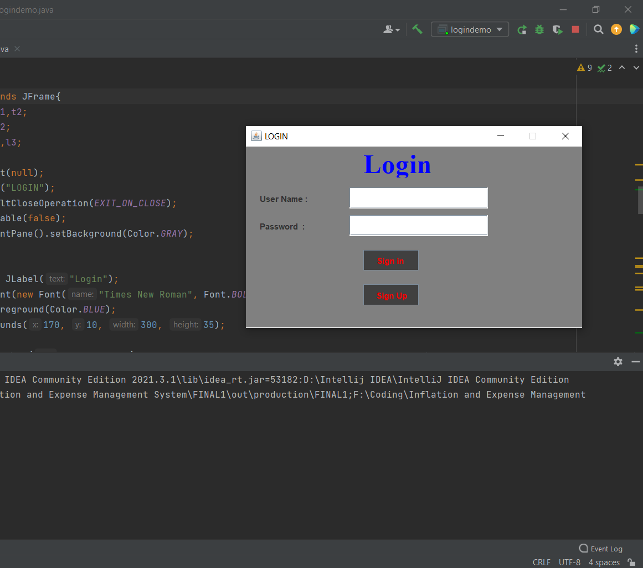
1. If we run the code then the Log in page arrives.

Slide 4
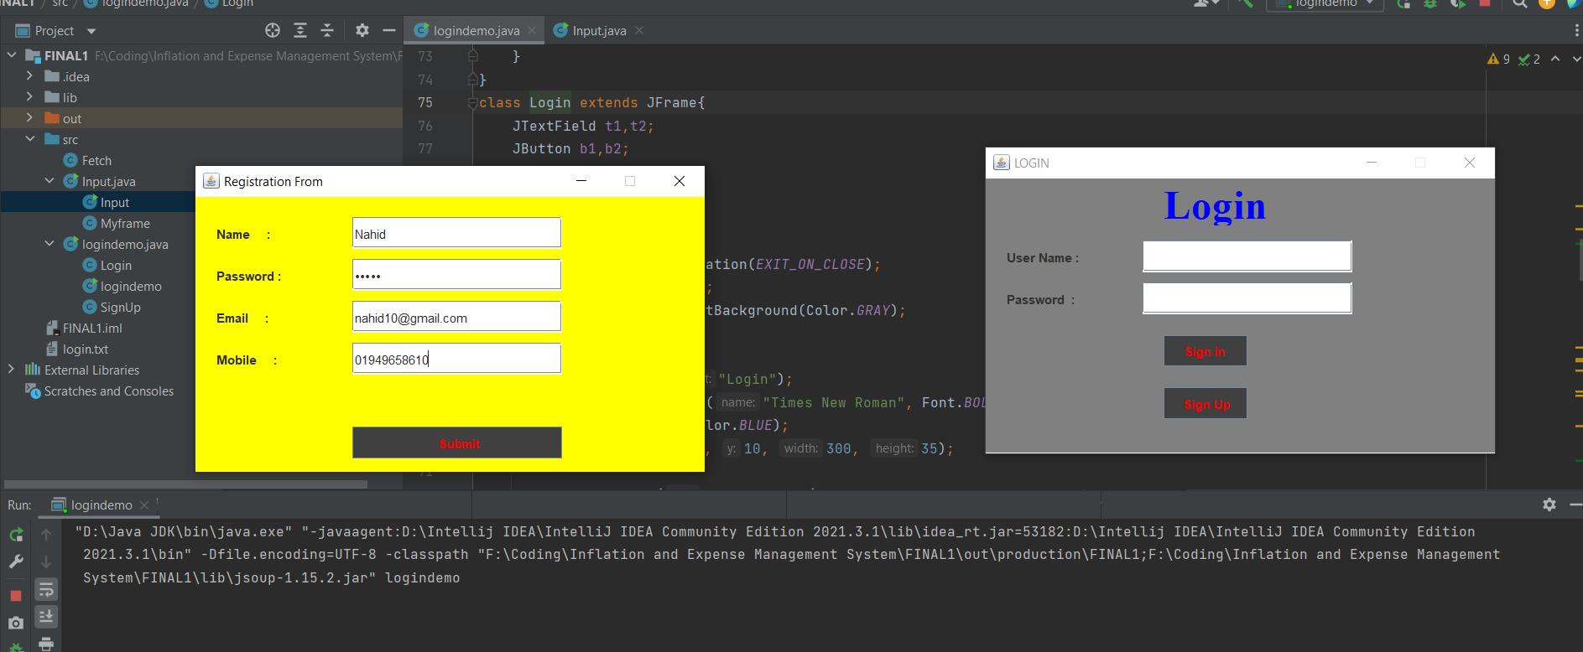
2. If you’re new then you have to sign up.

Slide 5
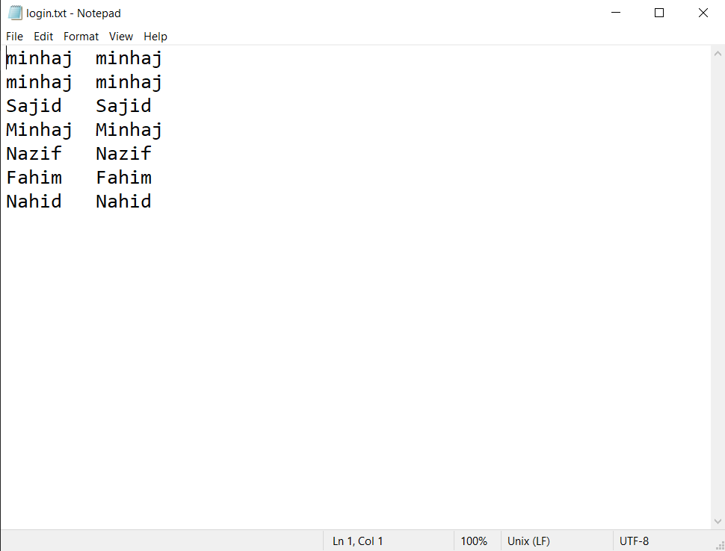
3. After signing up the username and password gets restored in a text file which will be used to sign in.

Slide 6
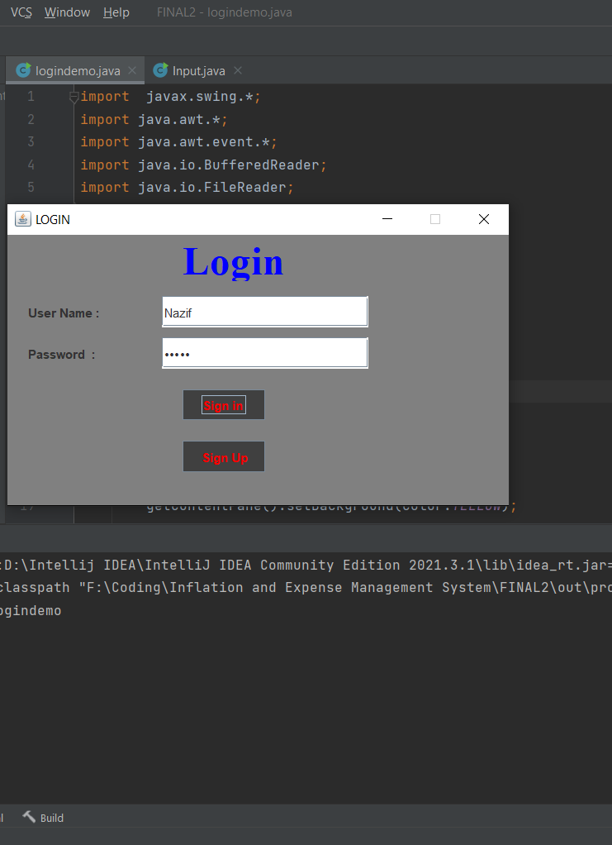
4.After signing up it’s time to sign in into the main management segment of the application by giving username and password.

Slide 7
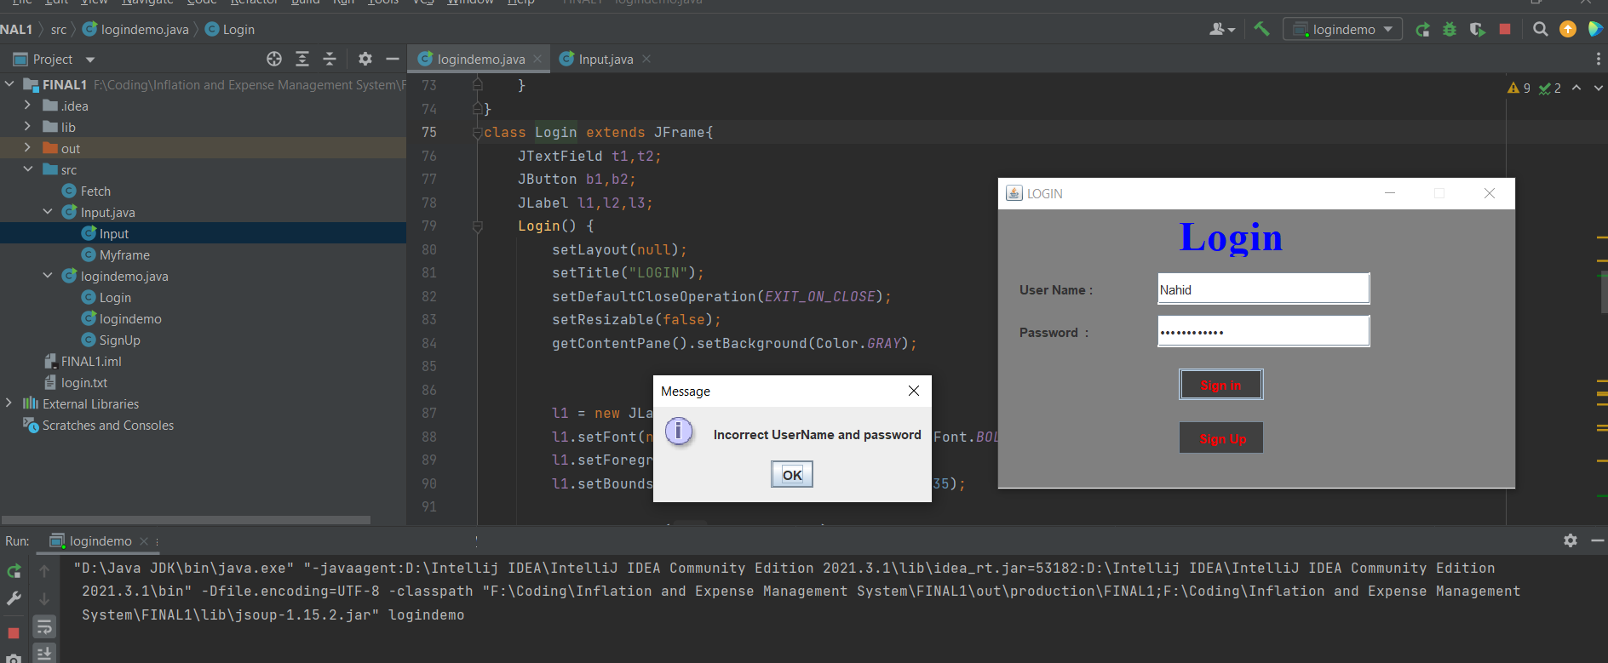
5.If the password or the username is incorrect then it’ll show that.

Slide 8
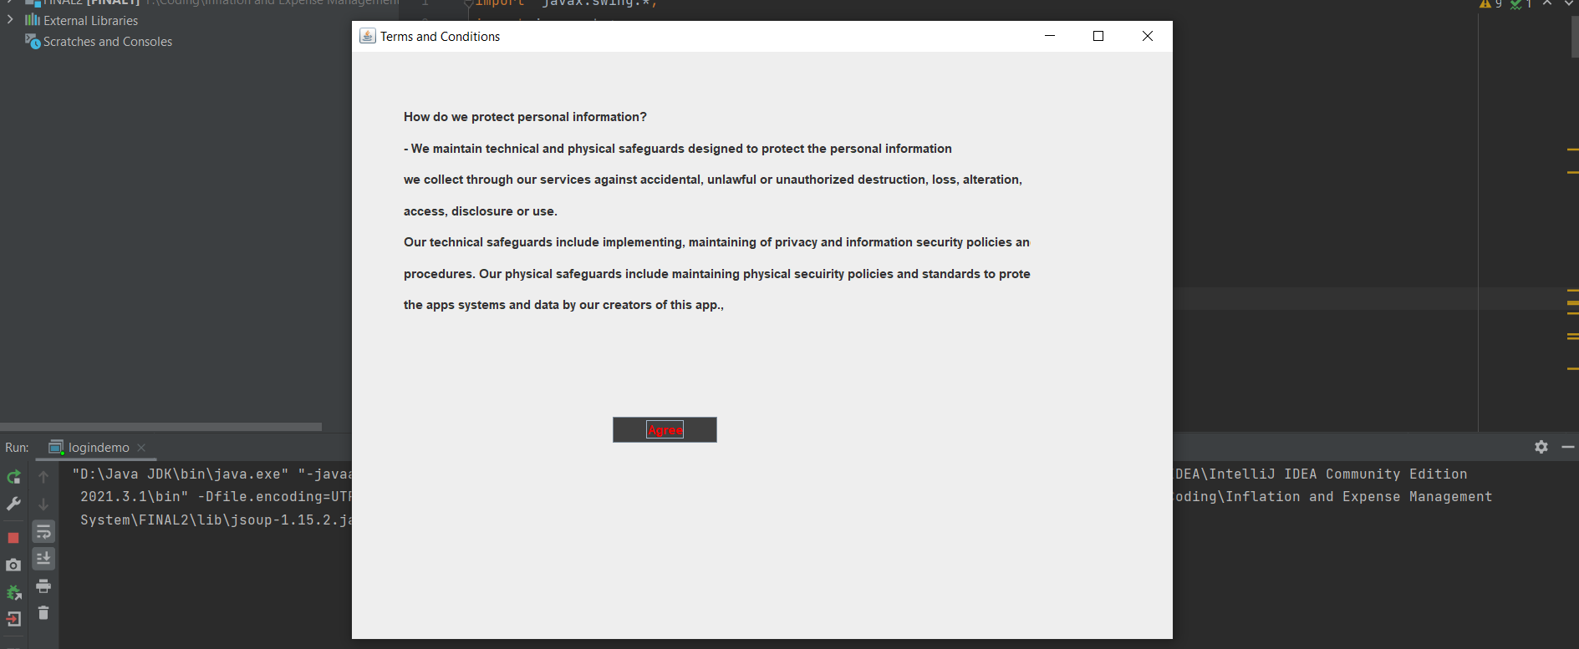
6. If the password is correct then there’ll be a window of Terms and conditions.

Slide 9
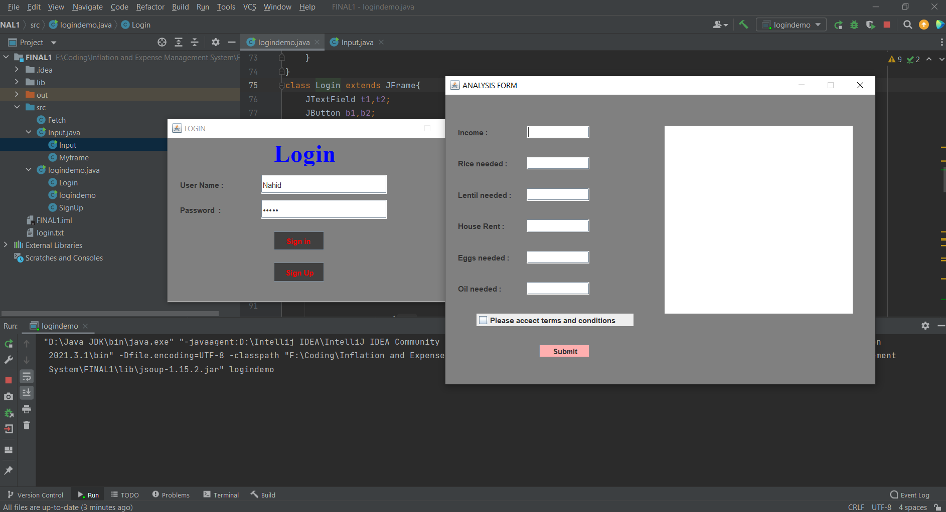
7. If the user agrees to the terms then he’ll enter the main management system.

Slide 10
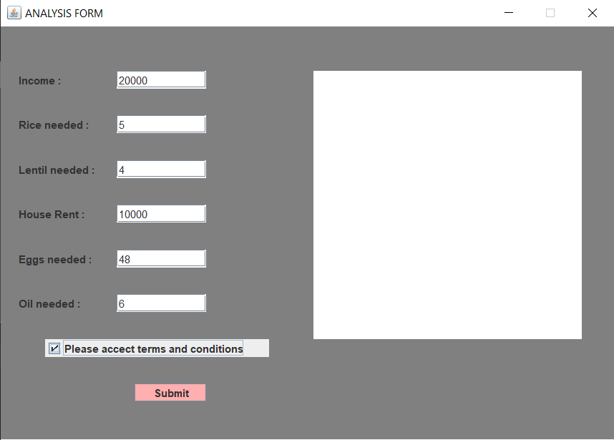
8. Then the user will input his income and daily necessities amount.

Slide 11
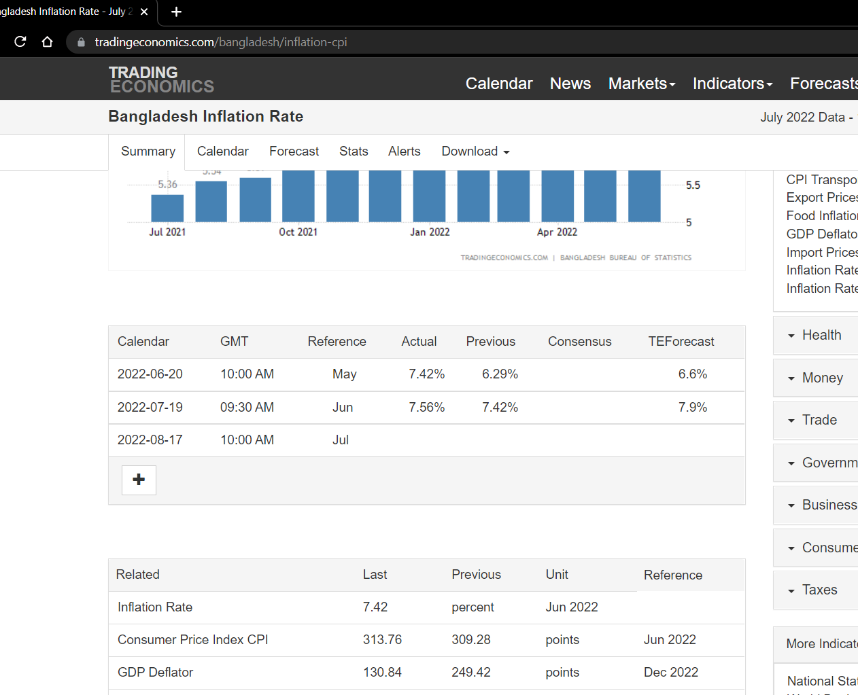
9. After submitting those then the program will fetch the inflation rates from the given website and make required calculations.

Slide 12
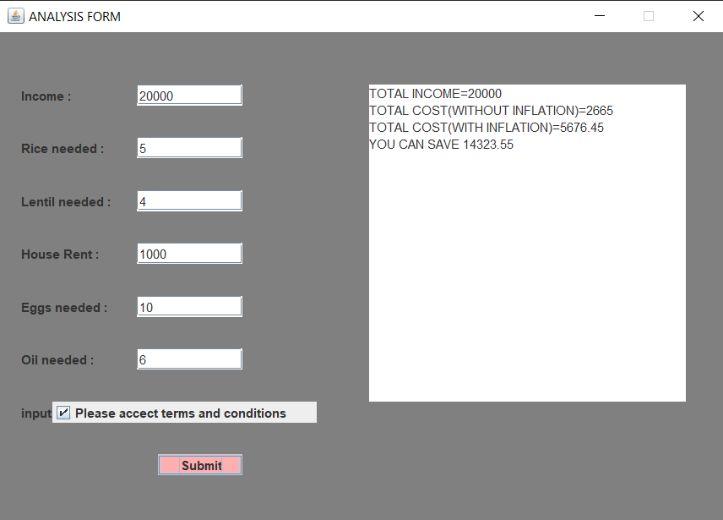
10. After doing the required calculation if user can save then it’ll show how much he can save.

Slide 13

11. And finally if he’s low on budget it’ll also show this.

Slide 14
THE
END.

